Slide 1
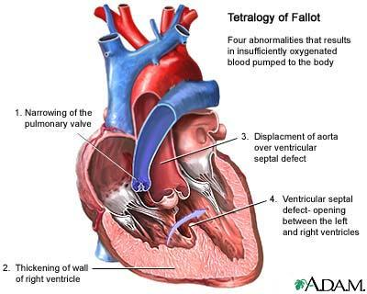
Tetralogy of Fallot
University Medical Center HCM city
Department of Cardiovascular Surgery

Slide 2

Contents
Brief Introduction of TOF
Preoperative Evaluation and Preparation
Current Management Strategies

Slide 3

Brief Introduction of TOF

Slide 4
History
Niels Stenson, 1st report, 1671
Arthur Louis Etienne Fallot, used “tetralogie”, 1888
Maude Abbott, termed “tetralogy of Fallot” (TOF) 1924
Van Praagh, Anderson: underdevelopment of subpulmonary infundibulum, monology

Slide 5
History of Surgical Management
Alfred Blalock, Helen Taussig, Vivien Thomas November 29 1944
Brock 1948, dilated the RVOT
Potts, Waterston, central shunt
Lillhei, 1954, intracardiac repair
Kirklin, 1955, using extracorporeal support

Slide 6

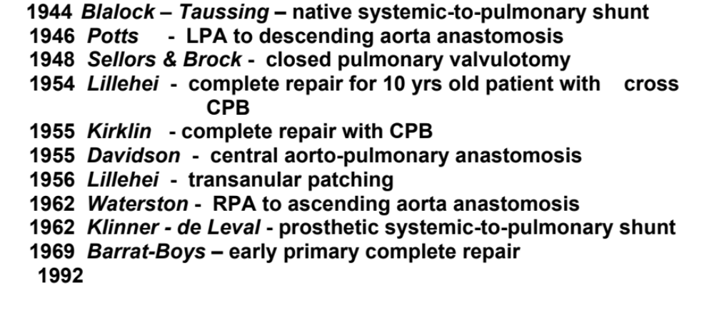
History of surgical management of TOF

Slide 7
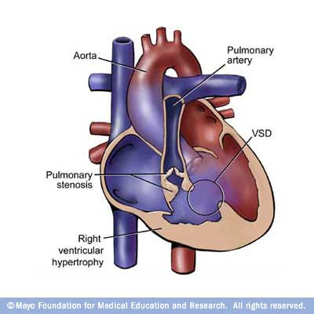
Definition
Four characteristics (tetralogy)
  RVOT obstruction
  Overriding aorta
  RVH
  VSD
Spectrum of TOF
  TOF with PA
  TOF with PS
  TOF with absent PV
Notes:
Prevalence: 1/2000 live birth
1. TOF with PA: PBF usu from MAPCA (multiple aortopulmonary collateral arteries)s
2. TOF-APV: increased PBF → massive enlargement of main and branched PA → airway compression and
tracheobronchomalasia
Tx: high level of PEEP for stenting the airway
3. Classic TOF: dyanmic component : hypertrophied infundibulum and muscle bundle fibers in RVOT
fixed component: PV lesion (thicken, hypoplastic, bicuspid)

Slide 8
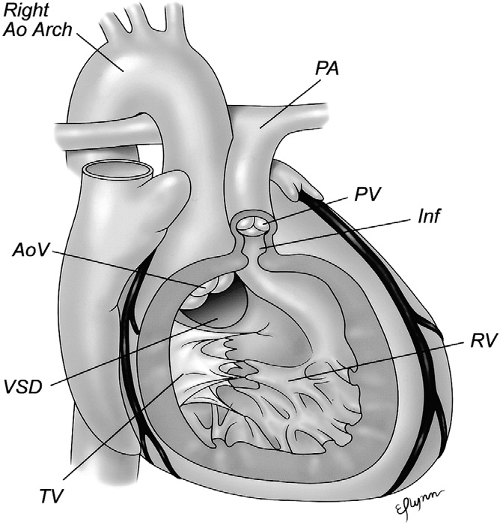

Slide 9
Incidence
2.5% of all CHD
Untreated 10 yrs survival 24%
Genetic syndromes: at least 20%

Slide 10
Natural history
Without surgery
  25~35% die in the first year of life
  40~50% die by the age of 4
  70% by 10 years
  95% by 40 years
  Chronic hypoxemia lead to polycythemia
With complete repair
  ＞85% survive to adulthood

Slide 11
Syndromic association
DiGeogre
Velocardiofacial syndrome
Down syndrome
Alagille syndrome
Cat’s-eye syndrome
CHARGE and VATER/VACTERL associations

Slide 12
Associated anomalies
  Right-side aortic arch (25%)
  Multiple muscular VSDs (3~15%)
  ASD (15%) PFO (50%)
  LSVC (10%)
  Coronary abnormalies (5%~10%)
  PDA (4%)
Notes:
LSVC: usu. Drains into the coronary sinus of RA
the vessel is usually tied off at the end of the surgery
→ a CVC placed via the left int. jugular vein will be rendered postoperatively
Full correction: between 2~10 months
Contraindication for primary repair: anomalous origin of coronary a., multiple VSD, inadequate PA anatomy

Slide 13
Pathophysiology
Pathophysiology of TOF depends on
  The degree of RVOTO
  Ratio of SVR to PVR
Clinical manifestation
  Pink tet
    TOF with adequate PBF
    Minimal RVOTO with a net L → R shunt
    Normal saturation
    Even signs of CHF
Notes:
Pink tet: TOF with adequate PBF (via PDA, MAPCA…)

Slide 14
Features
Anterior and cephalad deviation of infundibular septum
Malaligned VSD
Overriding of Ao
Pulmonary stenosis
RV hypertrophy

Slide 15
Diagnostic Focus
1. Suitability for total correction
Adequate size branch PA
Favorable coronary anatomy
Adequate size LV
Associated defects
2. Requirement for trans-annular patch
Pulmonary annulus size
Type of VSD

Slide 16
Presentation
Presentation differs as per age and degree of RVOTO, modified by PDA/collaterals
Infants
Children
Adult

Slide 17
Clinical diagnosis
Cyanosis depends on degree of obstruction and not on aortic override
Severe abstruction at birth
Cyanosis in 1st hours
Tachypnea
Metabolic acidosis
Respiratory alkalosis
May be ductal dependent

Slide 18
Clinical
Moderate obstruction at birth
Cyanosis in first few weeks
Systolic murmur (subpulmonary obstruction) at birth
May develop tet spells later

Slide 19
Clinical
Mild obstruction at birth
4-6 weeks with large VSD symptoms
Poor feeding, breathing difficulty, poor weight gain
With increasing RVOTO, overload symptoms improve and cyanosis appears

Slide 20
Clinical
Squatting episodes
Hypercyanotic spells
Common at 6 months to 2 yrs of age
Potentially life threatening or cause cerebral damage

Slide 21
Clinical
Chidren and adults
H/o tet spells
Poor exercise tolerance
H/o brain abscess
H/o syncope or seizures
History suggestive of RV failure

Slide 22
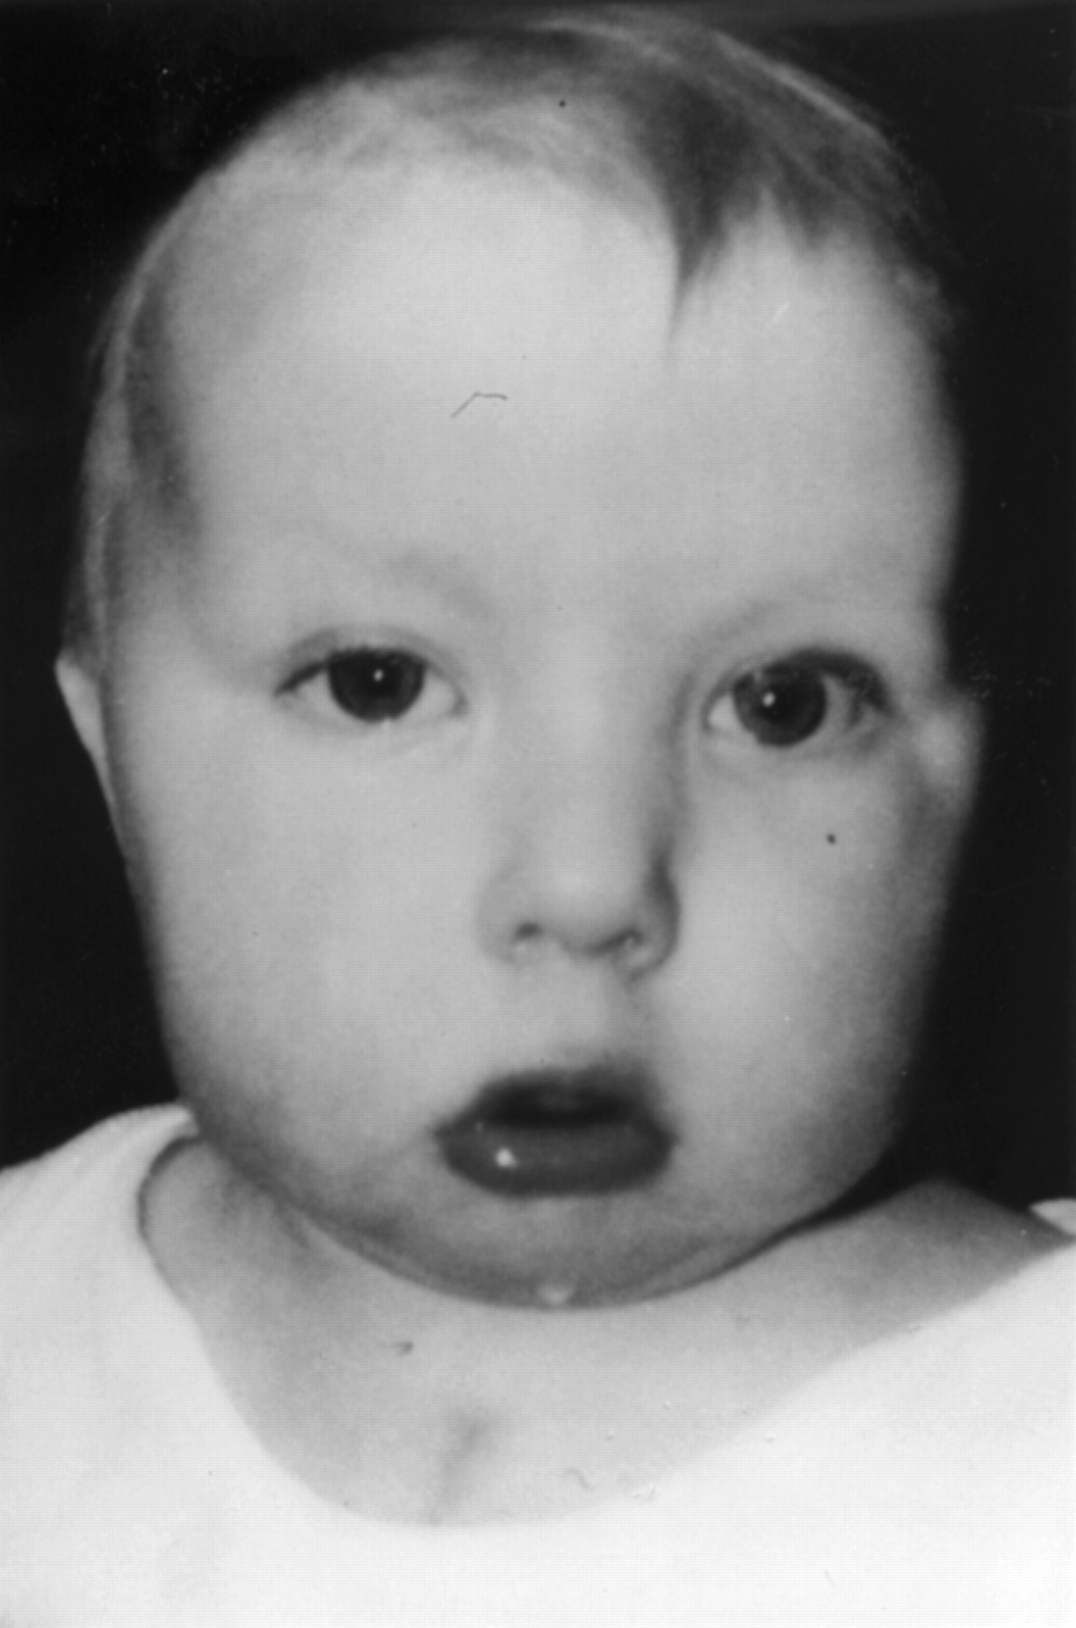
Physical examination
Dysmorphic features

Slide 23
Physical Examination
Infant with moderate or severe infundibular stenosis
Cyanosis
Clubbing after 2-3 months of age
Cardiac impulse normal or parasternal RV heave
Single second heart sound
Systolic ejection murmur duration varies with the degree of RVOTO

Slide 24
Physical Examination
Mild RVOT
Signs of volume overload
Intercostal or subcostal retractions
Hepatomegaly
Prominent parasternal impulse
Second heart sound is split with loud pulmonary component

Slide 25
Chest X ray
Severe stenosis
Reduced pulmonary vascular markings
Concavity at left upper cardiac border due to small PA
Upturned apex due to RVH
Prominent upper cardiac border: displaced SVC due to Rt Ao arch
Mild stenosis: pulmonary plethora
Moderate: normal pulmonary vascular markings

Slide 26
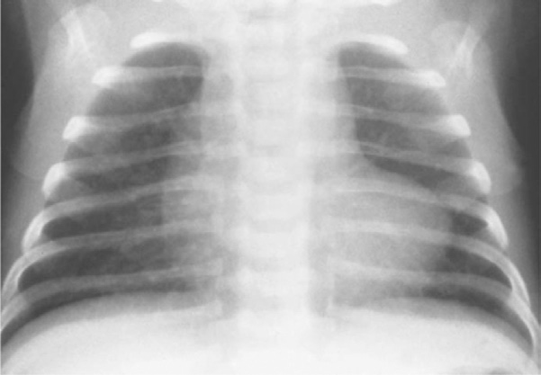
Chest X ray

Slide 27
Echo
VSD: 75% pm, superior border: Rt and non coronary cusp, posterior: tricuspid annulus
Doubly committed
Restrictive VSD and supra-systemic RV: rare, 1.5%
Ao override
PS: subvalvar stenosis, deviation of infundibular septum, hypertrophy of septoparietal trabeculations, doubly committed VSD

Slide 28
Pulmonary blood supply
Forward flow
PDA
MAPCAs: suprasternal short axis view
When multifocal blood supply: CTA or angiogram

Slide 29
Genetic study
Microdeletion of 22q11
15-35% of TOF
45% TOF-PA
65% TOF + APV
Parents of the affected child: predict risk for future pregnancies
50% risk of transmission if one parent is affected
Goldmuntz, Clark et al. 1998, Botto, May et al. 2003

Slide 30
Cardiac Cath
Diagnostic: rarely needed
Intervention: therapeutic
PDA stenting, RVOT stenting
Coil embolization of MAPCAs

Slide 31
High resolution CT scan
PA anatomy
MAPCAs
Coronary arteries
Systemic and pulmonary veins

Slide 32
Cardiac MRI
Assessment of pulmonary tree
Postoperative assessment
RV function, volume
Myocardial scarring
PR fraction

Slide 33
Echo Final report
Diagnosis of TOF
Type of VSD
Additional VSDs
Type and severity of infundibular/valvar obstruction
Size of PV annulus, Z score
Confluence and sizes of branch Pas at origin and before bifurcation, Z score

Slide 34
Echo final report
% of Ao override
RVH
Coronary artery anatomy with any evidence of major branch crossing RVOT
Size of LV
TR
LV, RV systolic and diastolic function
Others associated defects

Slide 35
Treatment options
Surgery remains the main treatment option
One-stage total correction should be the aim for all patients
Palliative surgery has an important role in specific situations

Slide 36
Current management
Evolution of surgery
1940’s – era of palliation
1955 – 1980’s: era of staged repair (transventricular)
1980’s – present: era of primary repair (transatrial)
1990’s: neonatal repair

Slide 37
Surgical Approach
Palliative procedures
  Balloon dilatation, RVOT stenting
  systemic-pulmonary arterial shunts
    Classic Blalock-Taussig shunt
    Modified Blalock-Taussig shunt (MBTS)
    Central shunt

Slide 38
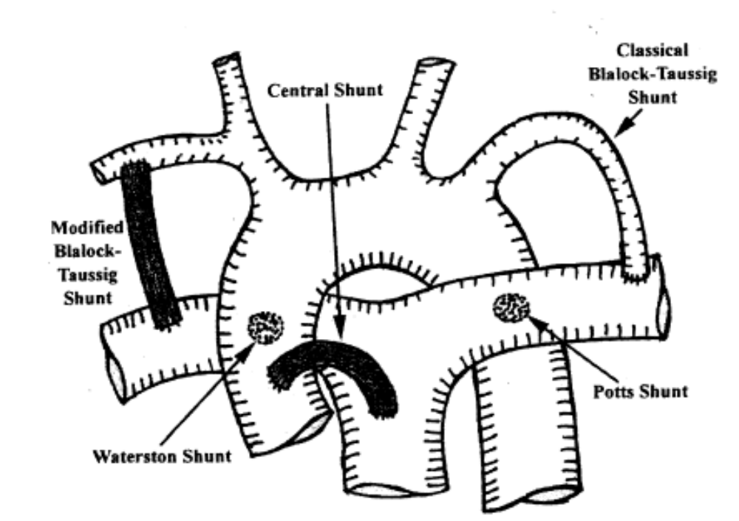

Slide 39
Palliative surgery
Age less than 3 months
Hypoplastic branch PAs
Pulmonary atresia less than 2 yrs
Co-morbid events precluding CPB
Recent CVA
Persistent thrombocytopenia

Slide 40
Goals of corrective surgery
Complete & secure closure of VSD
Complete relief of RVOT obstruction
While preserving:
RV, LV function
AV conduction
Tricuspid valve
Pulmonary competence if possible
Operative mortality < 3%

Slide 41
Indication for cath
Poor Echo windows
PA branches not visualised
Hypoplastic Pas
Multiple VSD
Suspicion of collaterals
Cardiologist/Surgeon un happy with Echo study
From Dr Krishna S Iyer (India)

Slide 42
Late presentation
Hematology, coagulation profile
Degree of malnutrition
Renal function
CT scan brain for occult infarcts/bleeds
Phlebotomy with fresh frozen plasma replacement beneficial in severe polycythemia

Slide 43
Corrective surgery
Transatrial vs transventricular approach
Many centers suggest superiority of transatrial approach
Disadvantages of transventricular approach may be nullified by using smaller ventriculotomy

Slide 44
TOF classical repair
Problems attributable to a large Rt ventriculotomy
Myocadial injury
Coronary injury
RV dysfunction
Arrhythmias
Pulmonary insufficiency

Slide 45
Transannular patch
PV annulus less than 2 mm + minimum acceptable (Rowlatt’s table) after pulmonary valvotomy
Very fibrosed annulus
Doubly committed VSD
Post bypass echo showing fixed gradient

Slide 46
Long term survival
Long-term survival in patients with repair of tetralogy of Fallot: 36-year follow-up of 490 survivors of the first year after surgical repair
Nollert G, Fischlein T J Am Coll Cardiol. 1997 Nov 1;30(5):1374-83
Actuarial 10, 20, 30 and 36-year survival: 97%, 94%, 89% and 85%

Slide 47
Late complications
RV complications
PV regurgitation, RV dysfunction
TR
Residual RVOTO
Arrhythmia and sudden death
Left heart complications
Ao root dilatation
AR
Residual shunts
VSD
MAPCAs

Slide 48
Minimizing post-op PR
Transatrial repair, minimal ventriculotomy
Accept mild residual RVOTO
PV annulus > -2: acceptable
Avoid neonatal repair
Monocusp/ leaflet augmentation?

Slide 49
Conclusion
Future of a child born with TOF today is far brighter than before
Some subtypes have less favorable outcomes
Surgical correction remains “palliative” and not “curative”
Improved understanding of long term complications compels appropriate modifications in surgical techniques
Surgical correction is not yet a “final act”

Slide 50
Knowing- Doing Gap
Would you let a great talker perform heart surgery on you? Sometimes NO
Not being confused: talking vs doing
Doing means learning. Learning means mistakes. We have to pay a price.
Make knowing and doing the same thing
One final insight: For successful people, there is no knowing-doing gap
The Knowing-Doing Gap: How Smart Companies Turn Knowledge Into Action
Stanford Profs Jeffrey Pfeffer and Robert I. Sutton

Slide 51
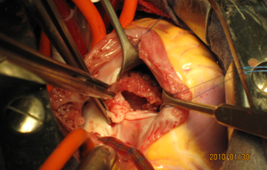
THANK YOU

